Slide 1
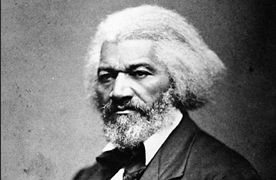
How do informational texts build my understanding about slavery in the United States?
Module 3: Narrative of the Life of Frederick Douglass
C-day Thursday, March 15th, 2018
D-day Friday, March 16th, 2018
M3U1L7

Slide 2


DO-NOW Learning Targets
I can reread a complex, above grade-level text (NotLoFD) to better understand and analyze it for multiple meanings.
I can cite several pieces of text-based evidence to support my analysis of our new central text, Narrative of the Life of Frederick Douglass written by himself.

Slide 3

How close reading looks with the NotLoFD –
ReReading for Multiple Meanings
First read: gist text and annotate evidence
Second read: answer comprehension-level questions in a few words
Third read: Jot down notes for TDQ/short-response style analysis questions. Answer these questions using CtEAC writing formula on separate sheet of paper

Slide 4


Before we read, let’s talk about what we do when we read closely.
Things Close Readers Do …
Get the gist – figure out what the text is mostly about
Cite evidence – identify strongest evidence to support analysis of informational text
Use details from the text to make inferences
Use context clues to figure out word meanings
Continuously think about how all this comes together for me as the reader after reading multiple times
Talk with others about the text

Slide 5
BB FF Protocol:
(from Excerpt 1, paragraph #3) This paragraph discusses Douglass’s parents. What does it show about how slavery affected children’s relationships with their parents?
Use evidence from the text to support your answer.

Slide 6
BB FF Protocol:
Analyze the impact Frederick Douglass’ mother’s death has on him. Use evidence from the text to support your answer.
Use evidence from the text to support your answer.

Slide 7
BB FF Protocol:
How does having power over their slaves seem to affect the overseer and the owner. Explain using details from the text.
Use evidence from the text to support your answer.

Slide 8
DO-NOW Learning Targets
I can reread a complex, above grade-level text (NotLoFD) to better understand and analyze it for multiple meanings.
I can cite several pieces of text-based evidence to support my analysis of our new central text, Narrative of the Life of Frederick Douglass written by himself.

Slide 9

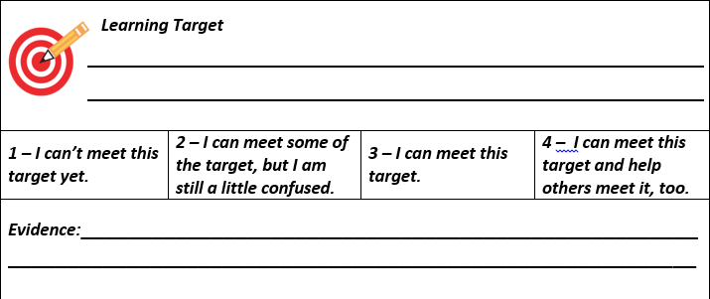

Exit Ticket – Learning Target Tracker

Slide 10



Homework –
Finish writing “NotLoFD” Excerpt 1 TDQs

